Slide 1
Md. Abdul Malek Assistant Professor, Dept. of Electrical & Electronic Engineering (EEE) Rajshahi University of Engineering & Technology (RUET)

Slide 2
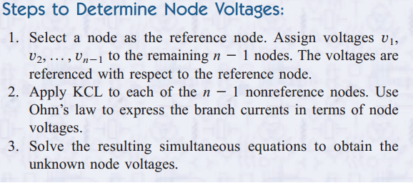
Nodal Analysis
Nodal analysis provides a procedure for analyzing circuits using node voltages as the circuit variables.

Slide 3
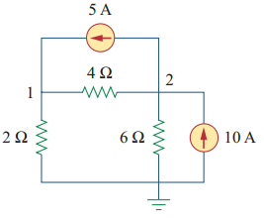
Nodal Analysis
Problem: Calculate the node voltages in the circuit.

Slide 4
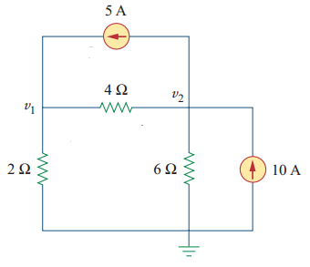
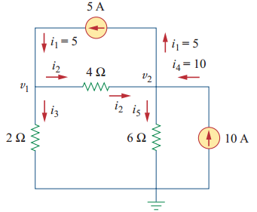
Nodal Analysis
Solution: Assign node voltages
Labeling of the currents is arbitrary
At node 1, applying KCL

Slide 5
Nodal Analysis
At node 2, applying KCL

Slide 6
Nodal Analysis
After solving equation (i) and (ii), we get,

Slide 7
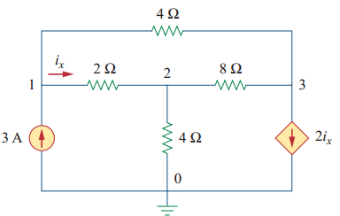
Nodal Analysis
Problem: Determine the voltages at the nodes.

Slide 8
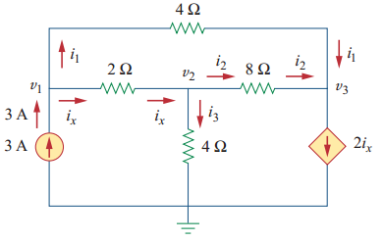
Nodal Analysis
Solution: Assign node voltages and labeling the current
At node 1, applying KCL

Slide 9
Nodal Analysis
At node 2, applying KCL

Slide 10
Nodal Analysis
At node 3, applying KCL

Slide 11
Nodal Analysis
After solving equation (i), (ii) and (iii), we get,

Slide 12
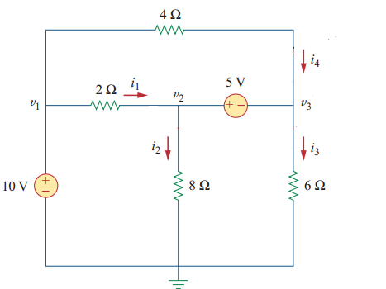
Nodal Analysis with Voltage Sources
If a voltage source is connected between the reference node and a nonreference node, we simply set the voltage at the nonreference node equal to the voltage of the voltage source.

Slide 13
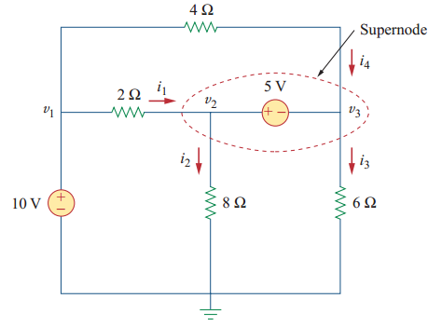
Nodal Analysis with Voltage Sources
If the voltage source (dependent or independent) is connected between two nonreference nodes, the two nonreference nodes form a generalized node or supernode; we apply both KCL and KVL to determine the node voltages.

Slide 14
Nodal Analysis with Voltage Sources
A supernode is formed by enclosing a (dependent or independent) voltage source connected between two nonreference nodes and any elements connected in parallel with it.
A supernode has no voltage of its own.
A supernode requires the application of both KCL and KVL

Slide 15
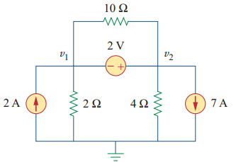
Nodal Analysis with Voltage Sources
Determine the voltages at the nodes.

Slide 16
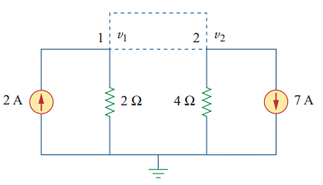
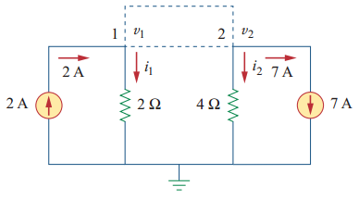
Nodal Analysis with Voltage Sources
Solution: The supernode contains the 2V source, nodes 1 and 2, and the 10Ω resistor.
Labeling of the currents is arbitrary
Applying KCL at supernode,

Slide 17
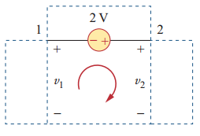
Nodal Analysis with Voltage Sources
To get the relationship between v₁ and v₂ we apply KVL
After solving equation (i) and (ii), we get,

Slide 18
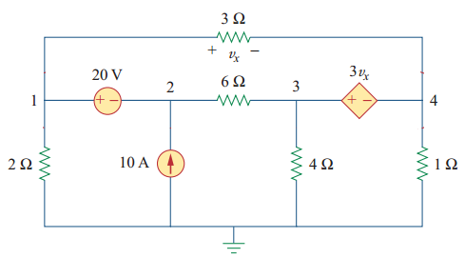
Nodal Analysis with Voltage Sources
Problem: Find the node voltages

Slide 19
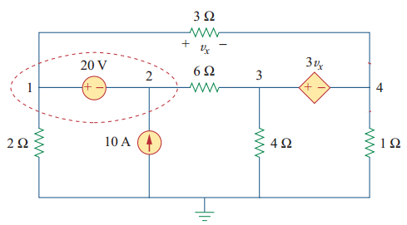
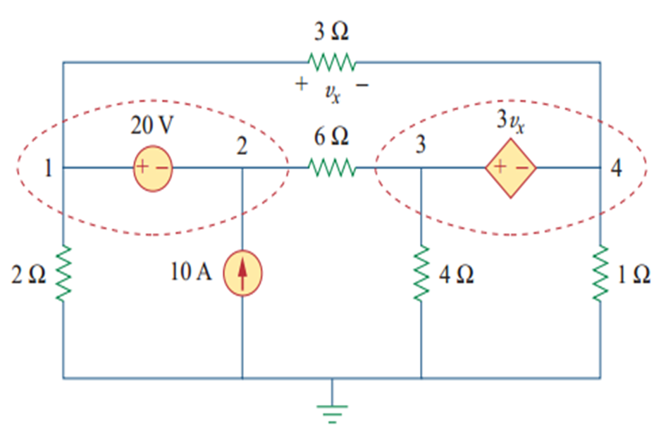
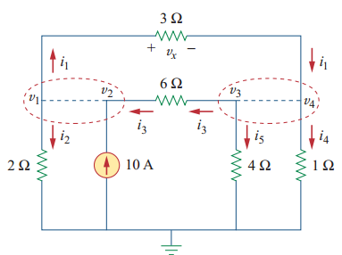
Nodal Analysis with Voltage Sources
Solution: Nodes 1 and 2 form a supernode
Nodes 3 and 4 form another supernode
Labeling the direction of currents

Slide 20
Nodal Analysis with Voltage Sources
Applying KCL at supernode 1-2,

Slide 21
Nodal Analysis with Voltage Sources
Applying KCL at supernode 3-4,

Slide 22
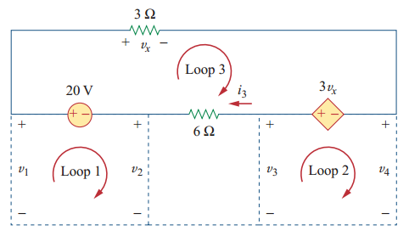
Nodal Analysis with Voltage Sources
Apply KVL to loop 1,
Apply KVL to loop 2,

Slide 23
Nodal Analysis with Voltage Sources
After solving equation (i), (ii), (iii) and (iv), we get,

Slide 24
Thank You

